Slide 1
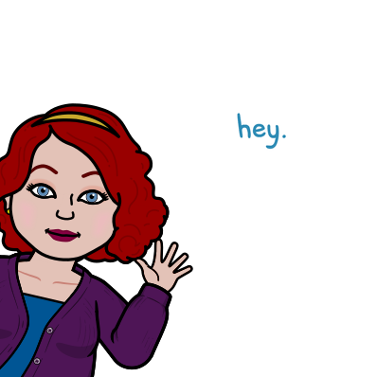
Miss Meade’s Classroom Rules
2022-2023 School Year

Slide 2
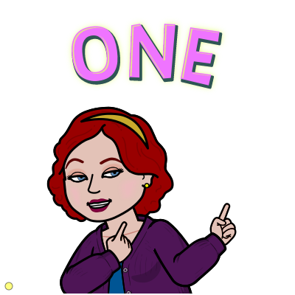
Put First Things First
When you walk in for class:
  Put your things down at your desk
  Check assignment board
  Check agenda board in back of room
  Turn in any homework
  Open Chromebooks for class
  Sit quietly for class to begin

Slide 3

Think Proactive, Not Reactive
Distracting others from learning does no one any good. To limit distractions:
  No gum
  No cell phones
  No fidget toys, unless approved by me
  NO DISRESPECT
I believe in multiple chances, but there will be times when you’ve been given enough warnings.
.

Slide 4

Seek First to Understand, then to be Understood
This classroom is a NO judgment zone
We are a family. Families don’t always get along, but we will respect each other.
There are no “stupid” questions. Help each other build strong answers. We are here to learn and have fun doing it!

Slide 5
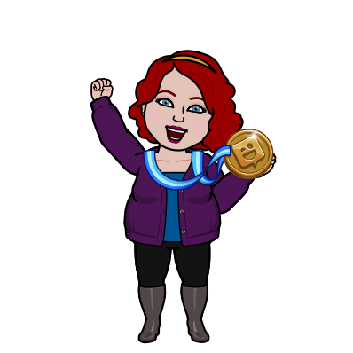
Think Win-Win: SCIENCE Competitions :)
I am a fairly competitive person, so I have built in competitions to our Science Curriculum
  Team Competition
  Solo Competition
The team competition is designed to help us build each other up, not tear each other down. Work together to win. :)

Slide 6

Think Win-Win: Cheating
I do not tolerate cheating.
Miss Meade. What is cheating?
  Copying and pasting anything from the internet to homework
  Looking at other people’s homework and copying it
  Giving a friend an answer to a homework assignment
If you cheat:
  You will get a zero on the assignment
  AND you will have to call home and explain what happened. This goes for ALL involved
  If you cheat again, You will get a detention.

Slide 7
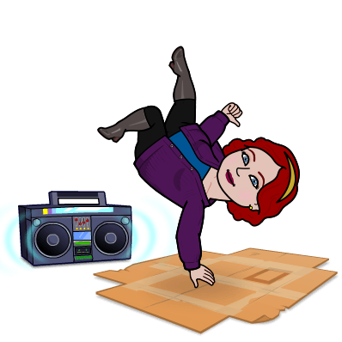
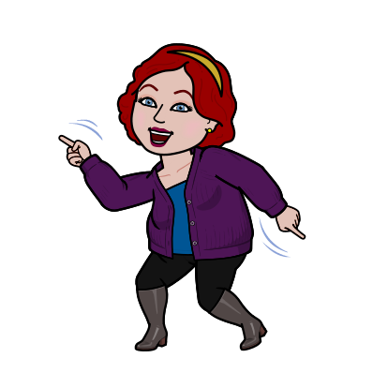
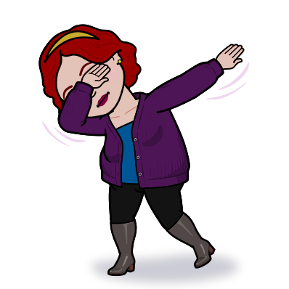
Synergize: We occasionally need a break
In the event that we are overwhelmed or need a break:
  If we are at a good point where we can take a break, we will take a break.
    Breathe, Dance, Stretch, whatever works for you

Slide 8
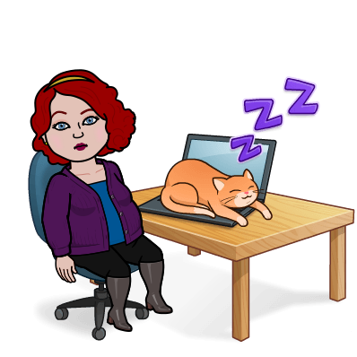
Reminder: Chromebooks
You need to be responsible for your own Chromebook.
Make sure you turn it in every day in Pride
Make sure it is plugged in the right way
Treat it with respect

Slide 9
Things to remember...
No one is perfect. We all make mistakes. We all have room to grow.
  I don’t pretend to know everything, so I don’t want you to pretend.
  We can always look up information and learn together
  If we get stuck, we can talk it through as a class to make sense of it.
I expect all of us to work hard and work together

Slide 10

Together we RISE…

